Slide 1
Financial Update
Angie Banks, CFO
October 8, 2024
Notes:
Good afternoon. I will be sharing the 1st quarter financial update which covers July through September 2024.

Slide 2
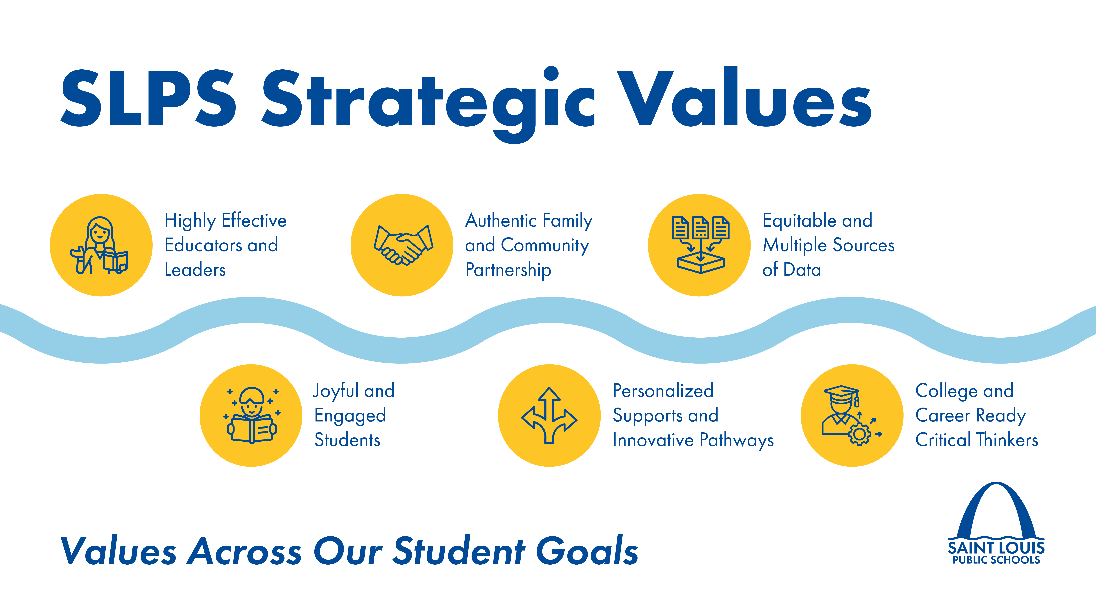
Notes:
Our financial goals are aligned with our strategic values and will do so in a sustainable way to support our student goals

Slide 3
Agenda
FY2023-24 YTD Preliminary Results
FY2024-25 Quarter 1 YTD Preliminary Results
  All Revenues by Source
  Payroll Expenditures
  Non-Payroll Expenditures by Category
Financial Outlook
Questions
Notes:
The agenda includes updates on FY2024 YTD prelim results and QTR 1 YTD preliminary results through September 28, 2024, the financial outlook followed with any questions.

Slide 4
FY2023-24 PRELIMINARY RESULTS
Notes:
Here are the FY2024 preliminary results through Sept 28. We received almost 92% of the budget revenues. We do anticipate additional federal revenues, primarily ESSER. We spent 95.5% of budget expenditures and anticipate only a few outstanding expenditures.
You can see how the quarterly revenues and expenditures line up. Please note how QTR 4 and the following QTR1 revenues are significantly less than QTR 4 expenditures. This is the primary need for the high fund balance – having the reserves to pay for ongoing expenditures until new tax revenue arrives in December and January.

Slide 5
FY2024-25: QUARTER 1
  Revenues: Property & Sales Taxes, Transportation, Adult Education, Special Education, Perkins
  Payroll Expenditures:
    Salaries – FY2025 increases budgeted based on FY2024 filled positions + 15% vacancies
    Benefits – 2025 medical/RX increase, 2026 pension increase
  Purchased Services:
    Instructional, Pupil & Staff Services – PD/coaching/consulting, PELP, employee evaluation management, STEM @ shelters, vector solutions
    Communications, Data Processing, Tech Repairs & Maintenance – Tyler Technology, PowerSchool (BusinessPlus), Rackspace, TSI Global, Huber & Associates, DocuSign, Frontline Education, Arbiter Pay, AT&T, Ricoh, HUDL, IPNS, E-Sports, MOSYLE
    Transportation & Food Service – alternate providers, cabs, McKinney Vento, parent gas cards, Metro bus passes, Chartwells
    Contracted Repairs & Maintenance – construction management, restroom renovations, moving services, grounds maintenance, cleaning & repair services, Advance Security
    Other Professional Services – property and employee fidelity insurance, insurance broker services, Robert Half and AOS staffing agencies
Notes:
1st quarter revenue is primarily GOB, property and sales taxes, transportation, no basic formula funds to date, but a few state and federal grants
A summary of expenditures are listed by category for the quarter, including payroll, legal, and utility expenditures. This quarter they are listed in the three main DESE categories with subcategories. The expenditures include all funds, thus why we need the healthy fund balance since many of these purchases won’t be reimbursed for at least a month and oftentimes several. Purchased Services is the first category with 5 subcategories. Each subcategory includes the type of expenditure and/or the vendors paid. For example, instructional, pupil, and staff service subcategories include the type of expenditures. Whereas the communications, data processing, tech repairs and maintenance subcategories include the vendors paid. We also have our check registers posted on the financial and community website where interested parties can search payments by vendor.
FYI if asked: School Mgmt Liability. Also commonly referred to as Directors & Officers and Employment Practices Coverages. Provides coverage for claims arising out of any actual or alleged breach of duty, neglect, error, misstatement, misleading statement, omission, wrongful employment practice, or educational malpractice. Two policies $3,000,000 Primary (RSUI) and $2,000,000 Excess (ACE Amer. Ins.) for a Total Limit of" $5,000,000.
Smaller federal grants - Rfgee Impct (RI) Afghan Refugee Grant Afghan Refg Impact S2S Parent Education PD Program AELSLATE 2023 Rfgee Impct (RI) Afghan Refugee Grant Afghan Refg Impact S2S Parent Education PD Program Afghan Refugee Grant E-Rate Tanf Grant

Slide 6
FY2024-25: QUARTER 1
  Supplies & Materials
    General, Instructional, Operational, and Technology Supplies, and Technology Hardware < $1,000 – Dell laptops, Softchoice for Microsoft product suite and antivirus protection, utilities plus 200+ pages of other supplies and materials
  Capital Outlay
    Furniture & Technology > $5,000 –
    Software > $5,000k – Kronos renewal
    Land, Building & Other Improvements – A Eilers, Hankins, and Interface general contractor services; Trane energy efficient projects; Cordogan Clark architectural & engineering services, CMT fencing
  Short- & Long-Term Debt
    General Obligation Bond Principal & Interest – administrative fees
Notes:
Supplies & Materials is the 2nd category with subcategories of general, instructional, operational, and technology supplies and technology hardware < $1k. Specific expenditures and vendors in these subcategories are numerous. The 1QTR report timed out for this category. Utilities would fall under this category with an annual spend of about $12M. Many of the supplies are purchased through Amazon
Capital Outlay is the 3rd category which are higher value items that may be depreciated over time versus expensed in the current year. Subcategories include furniture and technology > $5k, software > $5k, and land, building and other improvements.
FYI if asked: School Mgmt Liability. Also commonly referred to as Directors & Officers and Employment Practices Coverages. Provides coverage for claims arising out of any actual or alleged breach of duty, neglect, error, misstatement, misleading statement, omission, wrongful employment practice, or educational malpractice. Two policies $3,000,000 Primary (RSUI) and $2,000,000 Excess (ACE Amer. Ins.) for a Total Limit of" $5,000,000.
Smaller federal grants - Rfgee Impct (RI) Afghan Refugee Grant Afghan Refg Impact S2S Parent Education PD Program AELSLATE 2023 Rfgee Impct (RI) Afghan Refugee Grant Afghan Refg Impact S2S Parent Education PD Program Afghan Refugee Grant E-Rate Tanf Grant

Slide 7
FY2024-25
QUARTER 1 REVENUES
Notes:
We received about 15.4M of revenue in Quarter 1for a YTD total of 3.5% of the revenue budget through September.

Slide 8
FY2024-25
QUARTER 1 EXPENDITURES
Notes:
We spent about $75.3M in Quarter 1 for a YTD total 13.1% of the expenditure budget through September.

Slide 9
FY2024-25 FINANCIAL OUTLOOK
Strong Financial Position
  FY2024 Anticipated Unrestricted Fund Balance: $200M+, 45+%
Strategic Financial Planning and Budgeting
  Higher Costs:
    Payroll (Salaries, Benefits, Pension)
    Transportation
    Special Education
    Insurance
  Planned Deficit Spending in FY2025 and FY2026
Future Concerns
  ESSER Funding has sunsetted
  Legislation – Open Enrollment, Vouchers, State Budget
Notes:
Things are strong financially.

Slide 10
QUESTIONS?

